Slide 1
Chapter 2 – EXPRESS API LOG-IN AND DASBOARDS FUNCTIONALITY
Created By
Koustav Mukherjee

Slide 2
Content
INTRODUCTION
Create loginControler.js file
Create DashbordControler.js file
Update Routes.js file
Use postman to see the result

Slide 3
Introduction
In the previous lesson 1 we learn how create event and how to fetch a user details using the user id .
After that we add two more file add on Controllers folder one is LoginController.js and another is DashboardController.js.
Following path:
Src > Controllers > LoginContrellers.js
Src > Controllers > DashboardController.js

Slide 4
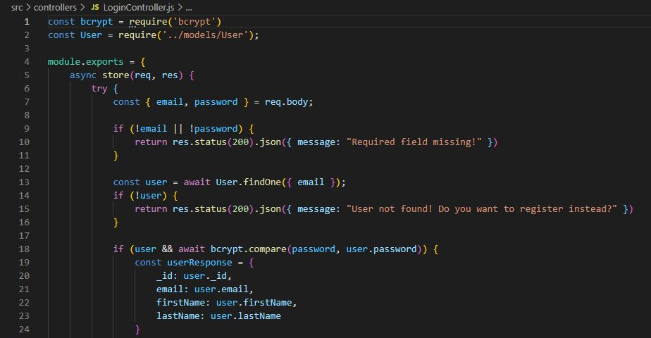
Create LoginContrellers.js

Slide 5
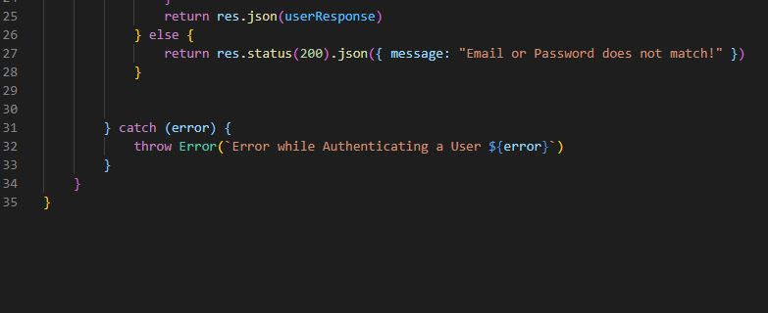
Create LoginContrellers.js

Slide 6
LoginContrellers.js
In loginController.js file we are add some that’s use our email and password if the email is correct its matches the email or password and gave the user details.
If any use gave wrong password then its show us email password doesn't match.

Slide 7
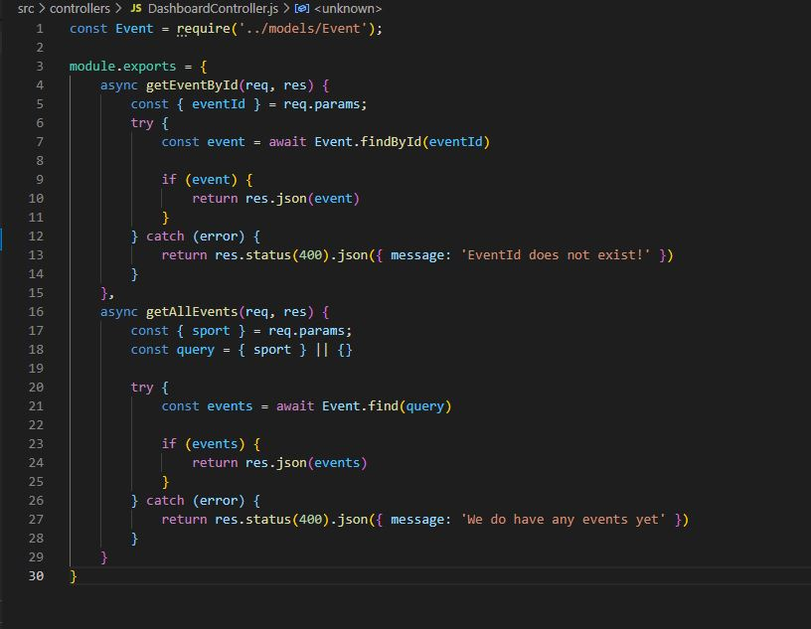
Create DashboardController.js

Slide 8
Explanation DashboardContrellers.js
In DashboardController we are use GetEventById() function that use a event_id and gave a result of those event.
Another function GetAllEvent() it is provide all the event are in database and show the result in Dashboard.
Using particular Sport name we can see the event on dashboard.

Slide 9
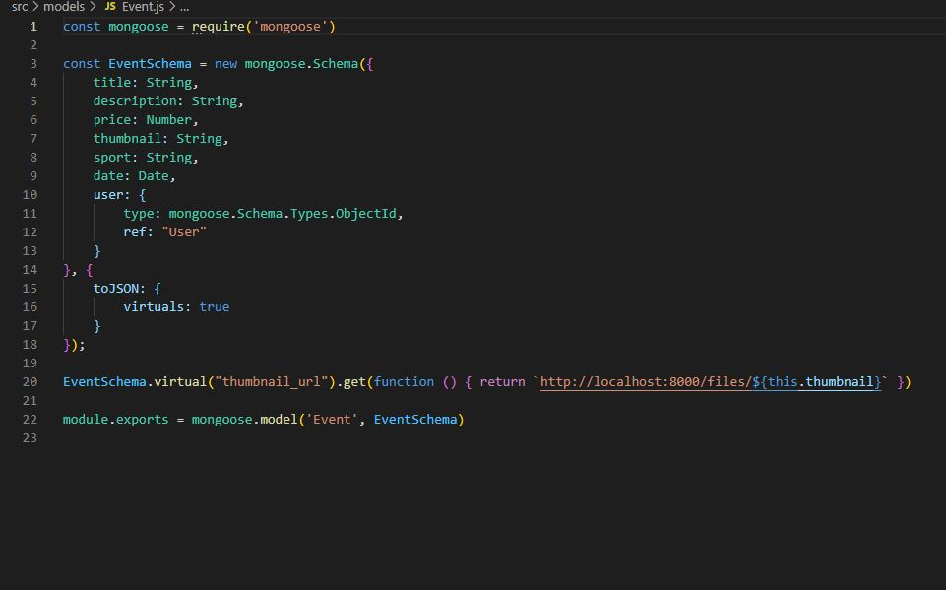
Create Event.js

Slide 10
Expiation Event.js
Event.js is our event Schema that use for create a event and store the event on database.

Slide 11
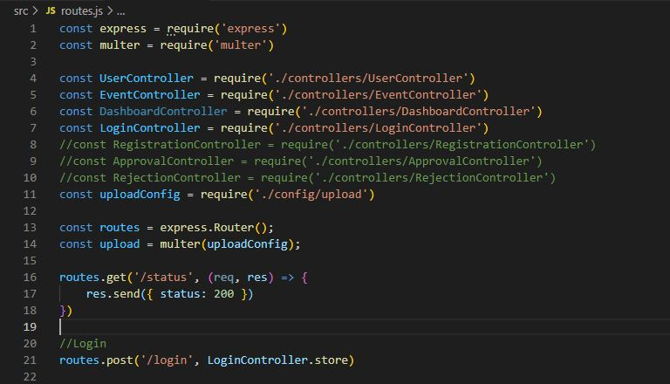
Create routes.js

Slide 12
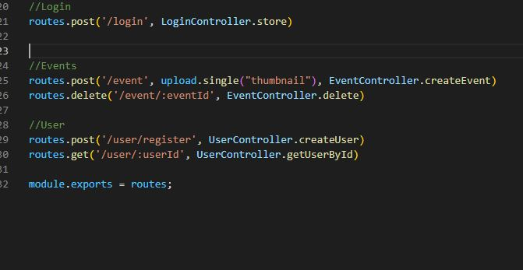
Create routes.js

Slide 13
Explain routes.js
After Completing the All Controller File we are add those file in Routes.js
Routes.js is a middleware that’s can connect to the other controller file and helps for Connecting to Server.

Slide 14
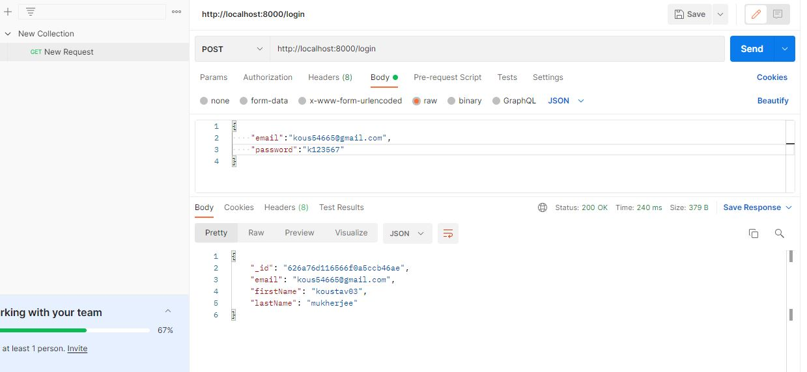
Use postman in login

Slide 15
Use postman in login
Step 1 – For new request go to “+” icon and add a new request .
Step 2 – Select method post and put localhost:8000/login
Step 3 – Select Body and go to Row and select JSON and then go and type email and password as JSON format.
Click on send and result is given bellow if exist or not then show password and email is wrong.

Slide 16
Use postman in dashboard
In dashboard part then we use event_id and Findout the particular event
In dashboard we put the /dashboard and see the result
In dashboard we put the /dashboard/sport and see the event that are sport event.

Slide 17
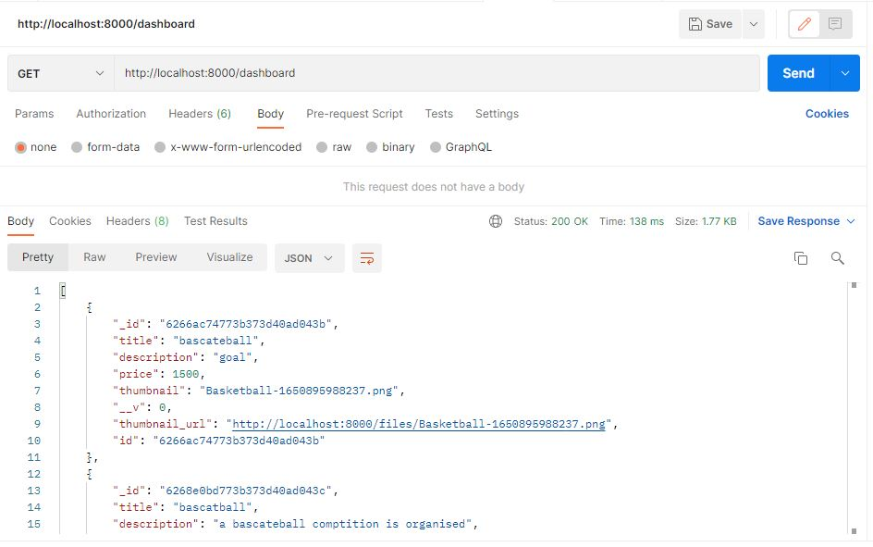
Use postman in Dashboard(/dashboard)

Slide 18
Use postman in Dashboard(/dashboard)
Step 1 – For new request go to “+” icon and add a new request .
Step 2 – Select method post and put localhost:8000/dashboard
Step 3 –Click on send and result is given bellow .

Slide 19
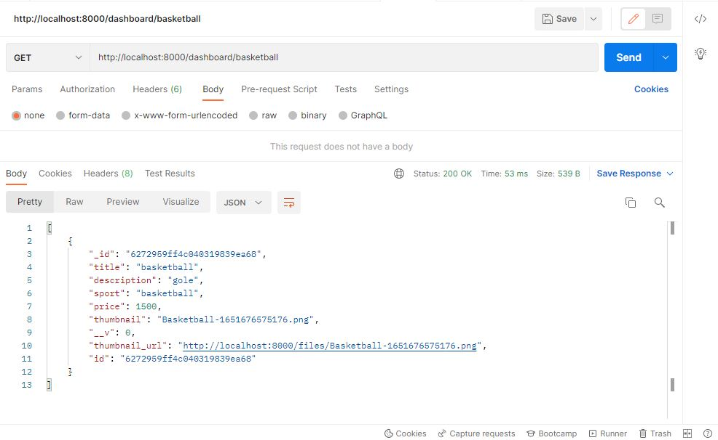
Use postman in Dashboard(sport)

Slide 20
Use postman in Dashboard(sport)
Step 1 – For new request go to “+” icon and add a new request .
Step 2 – Select method post and put localhost and then put the sport name like this localhost:8000/dashboard/basketball
Step 3 –Click on send and result is given bellow .

Slide 21
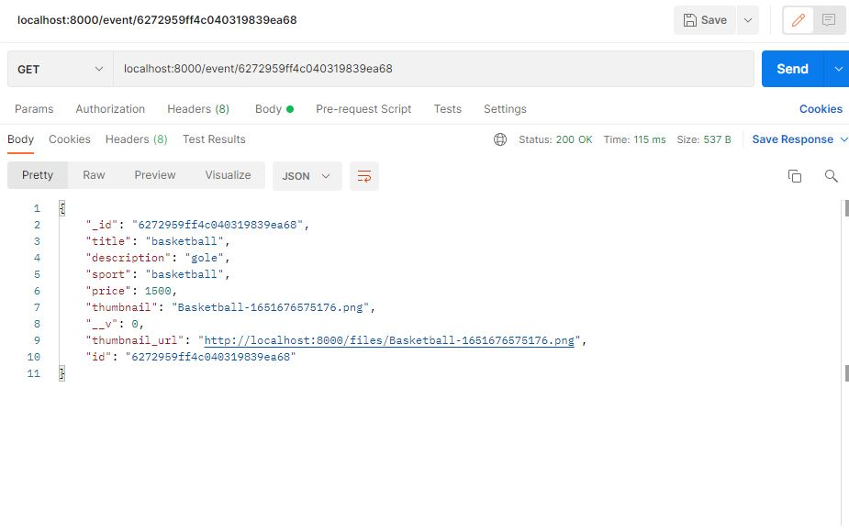
Use postman in Dashboard(event_id )

Slide 22
Use postman in Dashboard(event_id )
Step 1 – For new request go to “+” icon and add a new request .
Step 2 – Select method post and put localhost and then put the event-id like this localhost:8000/event/event_id
Step 3 –Click on send and result is given bellow .

Slide 23
THANK YOU

